Slide 1
Road Map
Evolution of Technology
Types of Data
Big Data- Definition Aspect
Big data Vs Not Big data
Challenges of big data

Slide 2
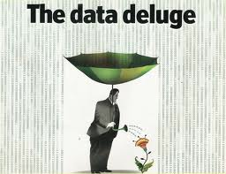

Slide 3
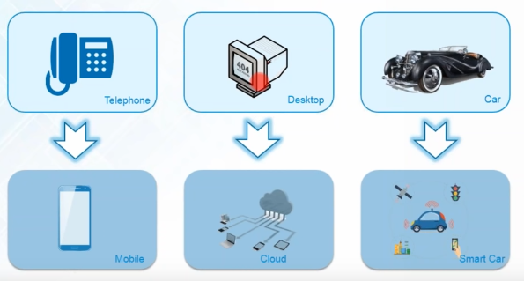
Evolution of Technology
Reference : https://www.youtube.com/watch?v=zez2Tv-bcXY

Slide 4
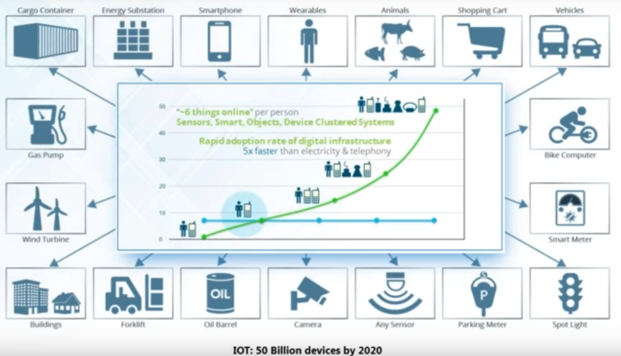
Internet of Things
Reference : https://www.edureka.co/blog/big-data-tutorial

Slide 5
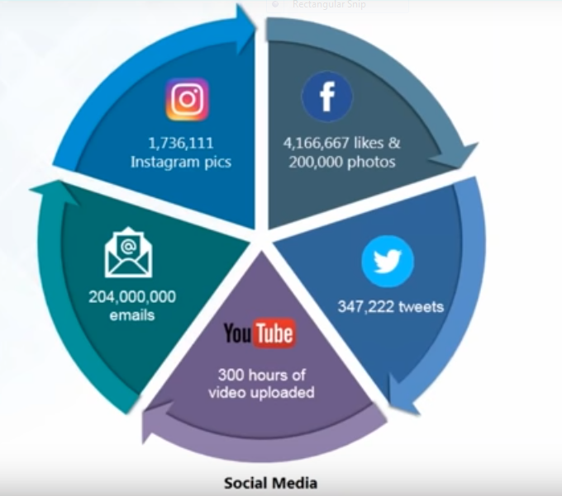
Social Media Usage

Slide 6
Classification of Digital Data

Slide 7
Digital Data

Slide 8
Structured data
When do we say that the data is structured??
When data conforms to a predefines schema/structure.
Sources of structured data

Slide 9
Working with structured data
Insert/update/delete
Indexing
Transaction processing
Security
Scalability

Slide 10
Semi-structured data
It does not conform to the data models that one typically associates with relational databases or any other form of data tables
It uses tags to segregate semantic elements

Slide 11
Sources of semi-structured data

Slide 12
Unstructured data
Does not conform to any predefined data model
The structure can be unpredictable.

Slide 13
Sources of unstructured data

Slide 14
How to deal with unstructured data?

Slide 15
Inclass#exercise

Slide 16
Solution

Slide 17
Let’s Discuss
Why email in unstructured category?
Where should we put CCTV footage?

Slide 18
You are at city shopping mall. You see few people are browsing the items. Some of them are looking for discounts. Some of them are filling feedback form. Few people are at billing counter. You may consider other things and events happening in this scenario. Think for while on the different types of data generated. Mention each of them with proper logic

Slide 19
You are at university library. You see few students browsing through the library catalog on kiosk. You see the working of librarians and other staff to issue/return books, magazines, and journals. Few students are using the e-library service, too. Which type of data is generated in this scenario? Support your answer by considering big data

Slide 20
Big Data – Definitional Aspects

Slide 21
Characteristics of Big data
Gartner’s 3V casted by Douglas Laney in 2001
Volume , Velocity and Variety
IBM’s 4V casted by Zikopoulos
Volume , Velocity , Variety and Veracity
Yuri Demchenko’s 5V
Volume , Velocity , Variety , Veracity and Value
Microsoft’s 6V
Volume , Velocity , Variety , Veracity , Value and Visibility

Slide 22
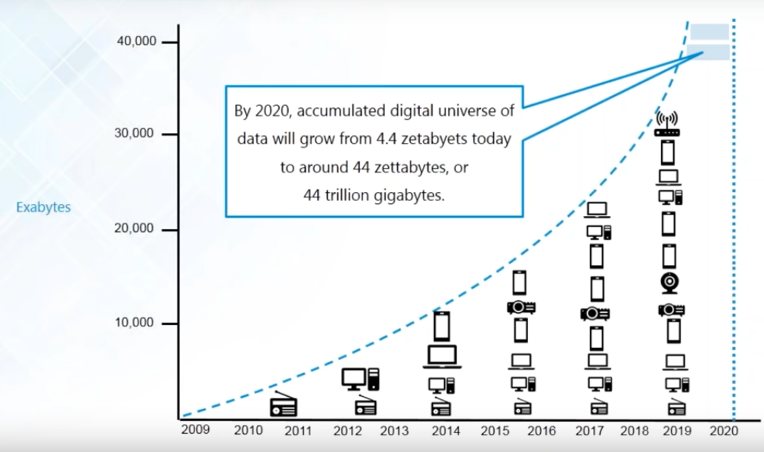
Volume

Slide 23
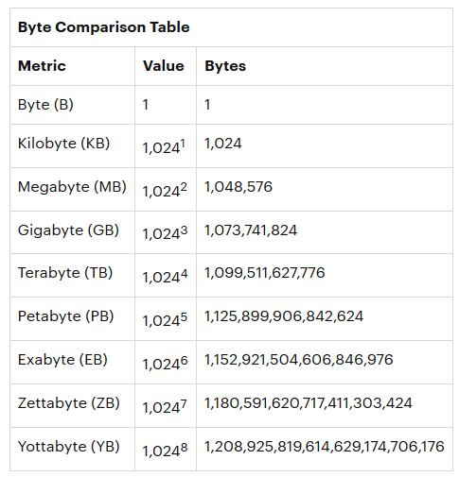

Slide 24
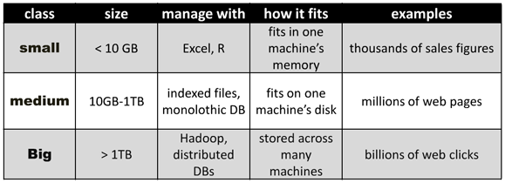

Slide 25
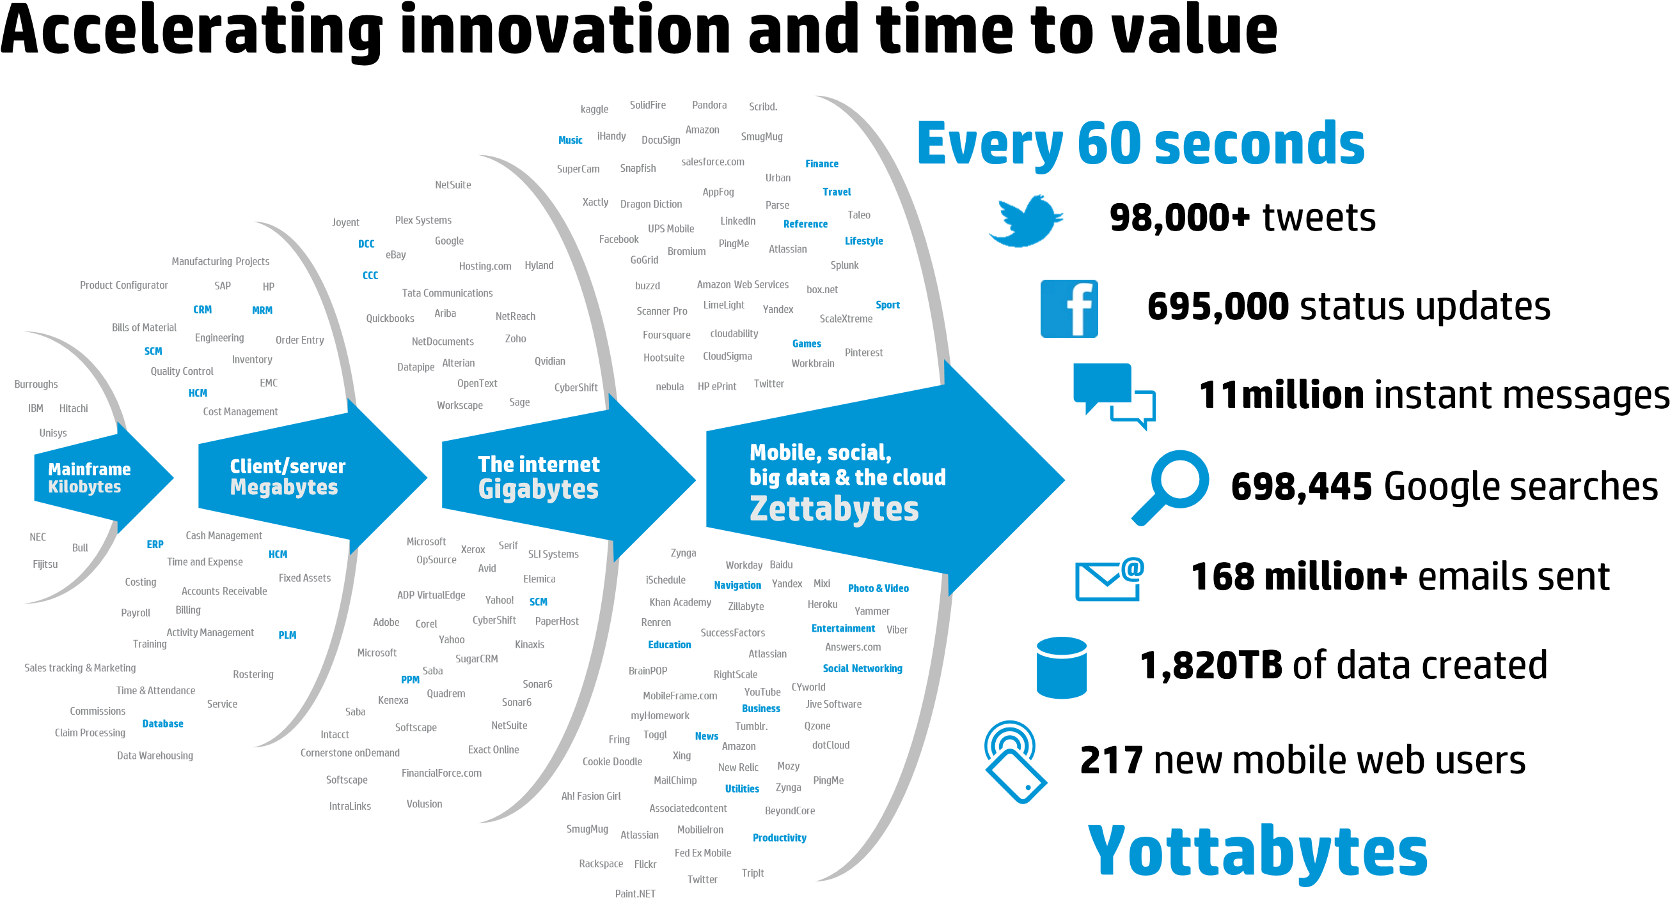
Velocity
Taken from : Hewlett-Packard Development Company “truths and myths about big data”,2013

Slide 26
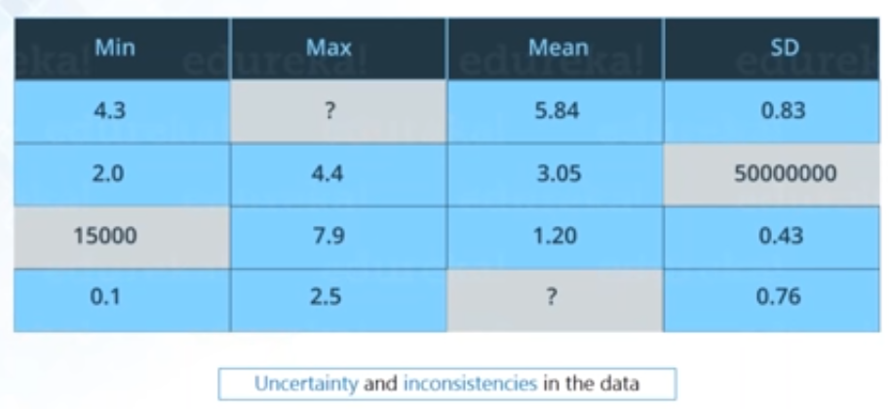
Veracity

Slide 27
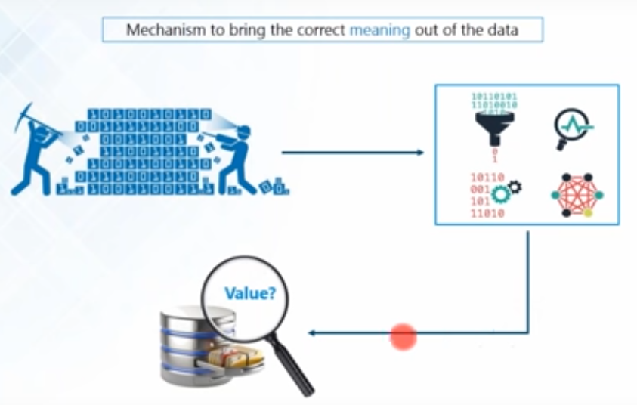
Value

Slide 28
What is big data about?
Answers are often “too big to ….”
Load into memory……..…Store on a hard drive…….…Fit in a standard database
“Fast changing”………..Not just relational
“Digital breadcrumbs” left behind (communication transactions..)—Hard little data particles left behind as people go about their daily lives
Open web data/social media data (facebook, twitter, blogs, online news, videos….)
Remote sensing (satellite, meters…)

Slide 29
What is big data about - and not about?
“Big Data is not about the data” (Gary King)
Institute for social science ,Harvard university
It’s about the analytics—the insights gleaned from the data; and the necessary capacities to do so—human, technological
One step further: it’s about knowledge: getting near to the ‘true’ meaning of a facebook status update;
It’s about sharing and diffusion – visualizations

Slide 30
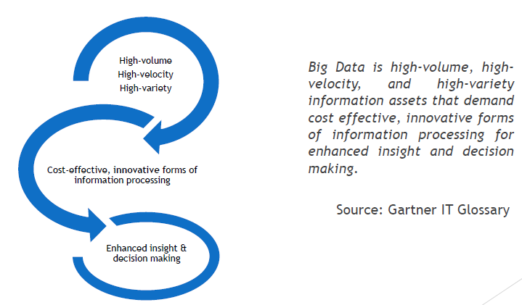
Big data Definition

Slide 31
Challenges with Big data

Slide 32
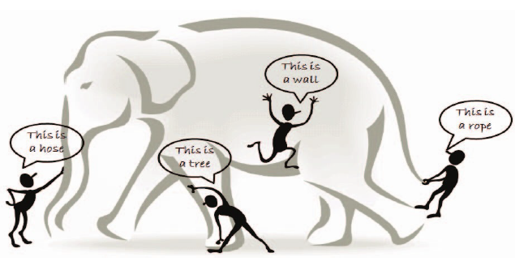

Slide 33
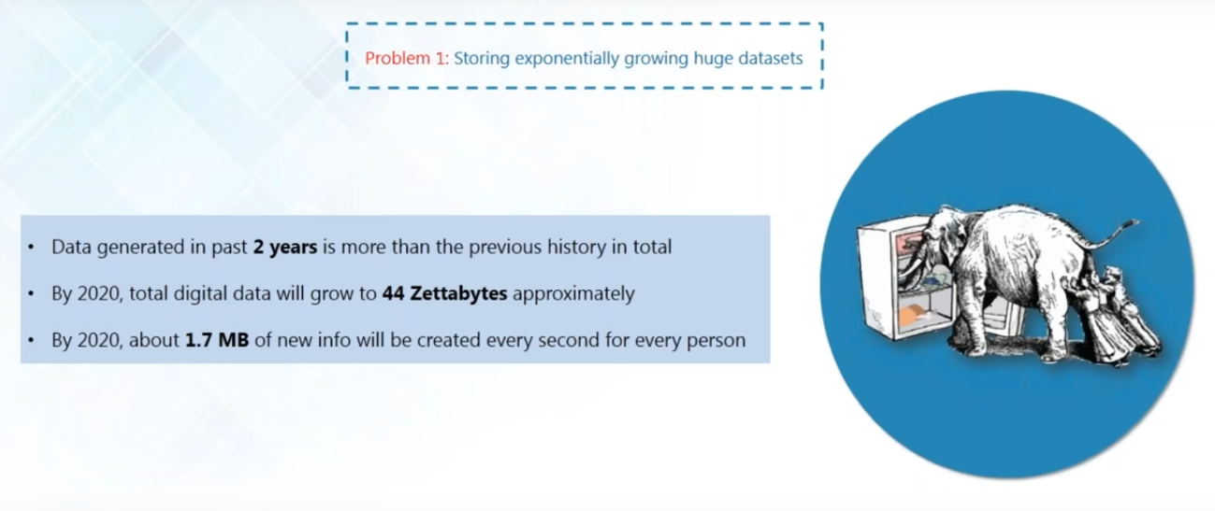
The problem is storing the colossal amount of data.

Slide 34
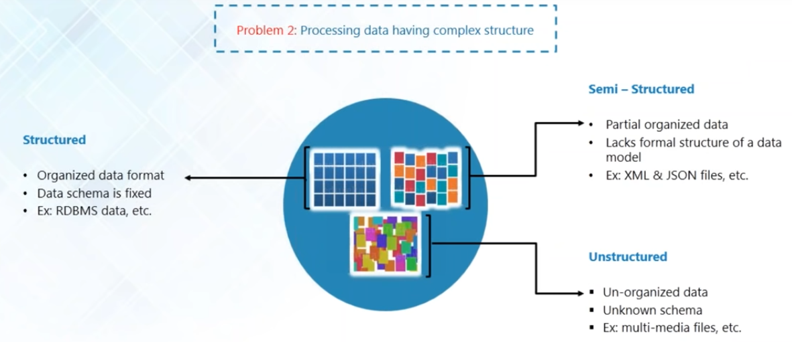

Slide 35
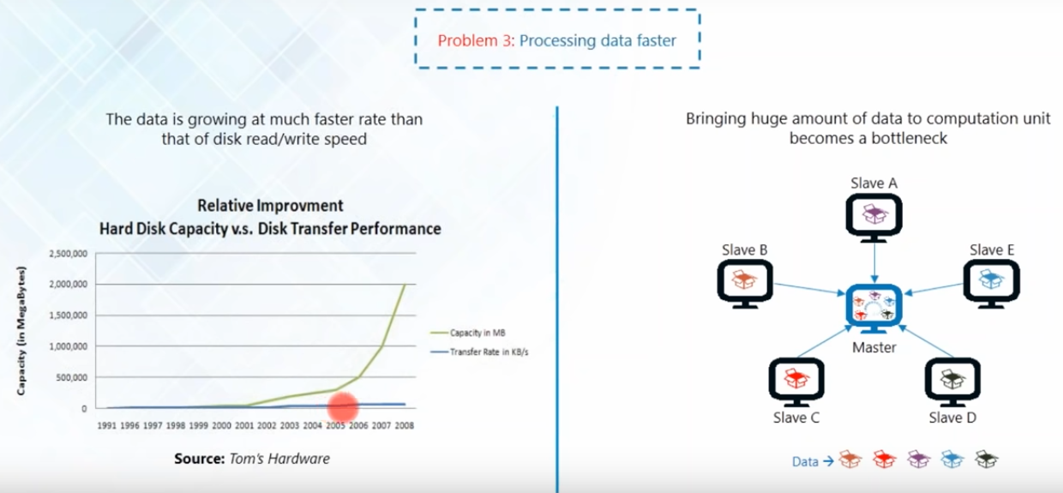

Slide 36
A big data analytics cycle can be described by the following stage −
Business Problem Definition
Data Identification
Data Acquisition & Filtering
Data Extraction
Exploratory Data Analysis
Data Preparation for Modeling and Assessment
Data Visualization
Analysis of Results
Business Problem Definition
Data Identification
Data Acquisition & Filtering
Data Extraction
Exploratory Data Analysis
Data Preparation for Modeling and Assessment
Data Visualization
Analysis of Results

Slide 37
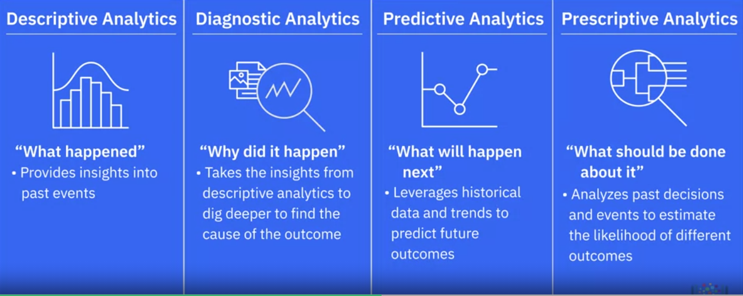
Classification of Data Analytics

Slide 38
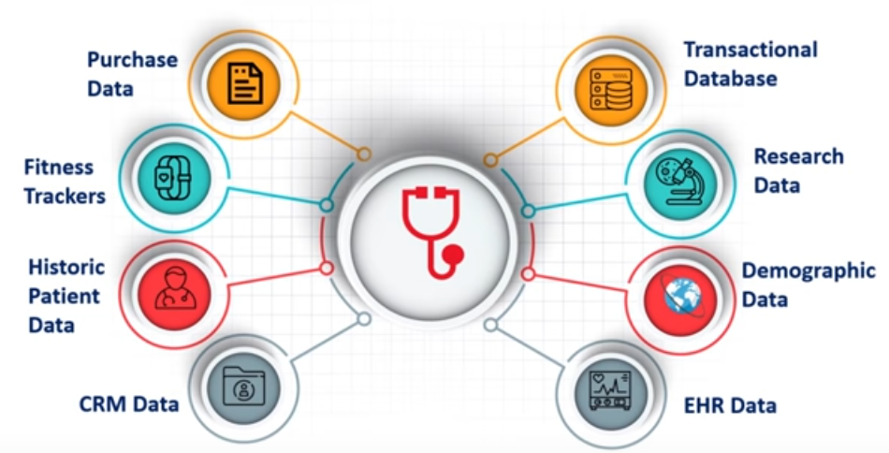
Big data Analytics-Case studies
Healthcare

Slide 39
Traditional Vs Big data Approach
OLTP: Online Transaction Processing
DBMSs
OLAP: Online Analytical Processing
Data Warehousing
RTAP: Real-Time Analytics Processing
Big Data Architecture & Technology

